Slide 1
Roman Key Card Blackwood and Splinter Bids

Slide 2
Roman Key Card Blackwood
RKCB – 4NT, asks for the number of Key Cards.
There are 5 Key Cards – 4 aces plus the King of trumps
You can also find out about the Queen of trumps
If trumps have not been agreed, RKCB is asking with the last bid suit set as trumps
1♥ – 4♣
4NT = RKCB in hearts, the splinter agrees a heart fit (explained later)
1♥ – 1♠
3♦ – 4NT is RKCB in diamonds, the last bid suit

Slide 3
Roman Key Card Blackwood (1430)
Responses:
5♣ = 1 or 4 keycards
5♦ = 0 or 3 keycards
5♥ = 2 without the Q of trumps
5♠ = 2 with the Q of trumps
After 5♣ or 5♦response, the next suit up (as long as it is NOT the trump suit) asks for the Queen of trumps
Responses:
First step = no Q trumps
Second step = Q trumps, no outside Kings
Third step = Q trumps + 1 outside King ….etc

Slide 4
Roman Key Card Blackwood
You are more likely to look for a slam after partner shows 1 keycard rather than none, so the 5♣ response allows room to ask for the Q trumps
Where the trump suit is a major you can stop at the 5-level if you are missing Q trumps
If you have all 5 keycards and either you or partner have the Q trumps (or there is a 10+ fit) then 5NT asks for outside Kings, looking for a grand slam
Responses:
6♣ = 0 outside kings
6♦ = 1
6♥ = 2
6♠ = 3

Slide 5
Splinters
A double jump in a new suit is always a splinter and either of the partnership can use a splinter
Eg: a)1♠ – 4♣ b)1♦ – 3♥ c)1♥ – 1♠ d)1♣ – 1♥ 4♦ 3♠
A splinter shows:
a fit for partner’s suit
a singleton or void in the bid suit
at least game values and interest in a slam

Slide 6
Why are splinters so useful?
♠ 8 7 5
♥ K Q J 9 8
♦ A K 4
♣ K 5
♠ 6
♥ A 7 6 2
♦ Q J 10 9 6
♣ A J 2
West East
1♥ 3♠
4NT 5♥
6♥ all pass
1st example: West knows their partner’s singleton ♠ controls their potential 3 small losers in ♠s, so they successfully look for a small slam reaching 6♥
♠ A K 4
♥ K Q J 9 8
♦ 8 7 5
♣ K 5
♠ 6
♥ A 7 6 2
♦ Q J 10 9 6
A J 2
West East
1♥ 3♠
4♥ all pass
2nd example: West can see partner’s singleton duplicates the value of their ♠K, so they sign off in 4♥. Note that, if they were to look for slam, even 5♥ can be defeated on a ♦ lead after ♦A, ♦K and a ♦ ruff.

Slide 7
Splinters
Once partner has made a splinter, re-evaluate your hand
Having 3 or 4 small cards opposite a singleton is good - you will be able to ruff them. Your high cards will also be fitting with partner’s honours
Honours apart from the Ace, eg KJ64 opposite a singleton = some wasted values
Following a splinter you can sign off in game with a minimum hand
With slam interest you can use RKCB – 4NT. Cue bidding is another method to investigate slam but will NOT be covered in this lesson

Slide 8
Splinters
1♠ – 4♣(splinter agreeing spades) what do you rebid with:
a)♠AQJ84 b) AQJ84 c) AQJ84 d) AQJ84 ♥AJ7 QJ7 A652 KQJ9
♦K5 6 85 7
♣764 KJ96 Q7 A76
4NT (RKCB) 4♠-wasted ♣’s 4♠-minimum 4NT(RKCB)
Example auctions:
a)1♥ – 4♦ b) 1♥ – 3♠ c) 1♠ – 4♣ d) 1♠– 4♣ 4♥ – 4NT 4♥ – P 4NT – 5♣ 4NT – 5♠ 5♥ – 6♥ 5♠ 7♠
Opener minimum opener min after splinter opener asks
But responder asks high enough opener asks enough for 7

Slide 9
Splinters
However, if a new suit at the 2 or 3-level would be natural and forcing (eg: reverse bid) then a single jump is a splinter
a) 1♥ – 2♦
3♠ ….(2♠ would be natural, GF reverse after 2♦)
b) 1♠ – 2♥
4♣ ….(3♣ would be natural, GF)
c) 1♥ – 1♠
2♥ – 4♦ ….(3♦ would be natural, GF)
d) 1♣ – 1♥
2♠ …. IS NOT A SPLINTER – it’s a strong hand, 18-19

Slide 12
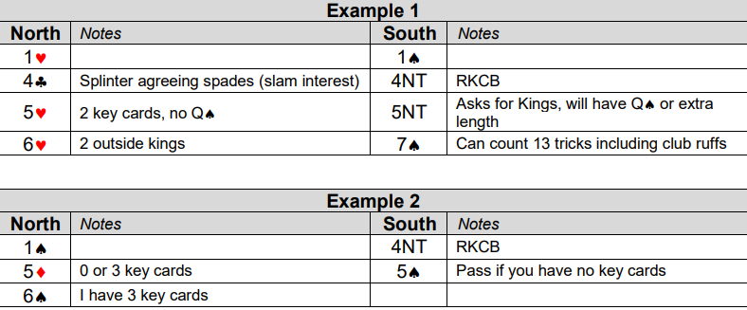
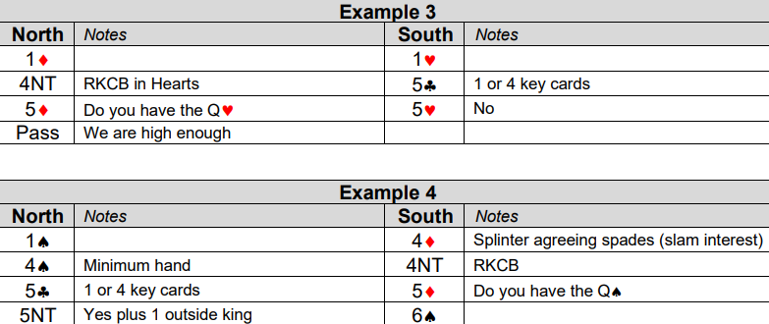
Example Auctions

